Slide 1

HELLO EVERYONE!
2

Slide 2



WHO ARE WE?
BEDİRHAN ÖZTÜRK
AHMET ENES TOPÇU
E-mail: ozturkbed21@itu.edu.tr
E-mail: topcua21@itu.edu.tr
Faculty: Computer And Informatics Faculty Department: AI And Data Engineering
3

Slide 3

USING RENEWABLE ENERGY IN CHINA

Slide 4
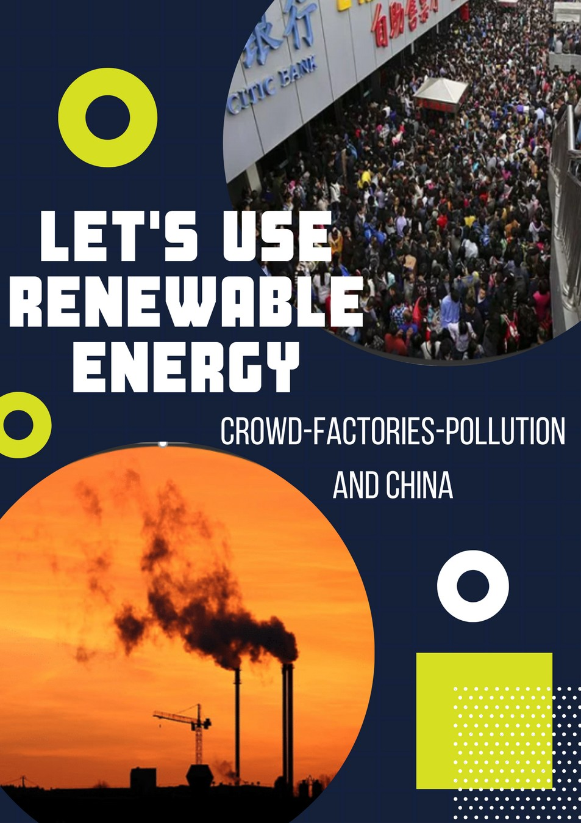
OUR POSTER
-Our poster has some messages.
-It points out using renewable energy.

Slide 5
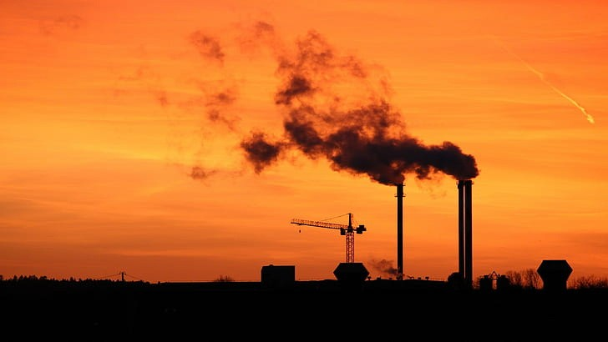
Why did we use these pictures 1 ?
#Representing factories in China #Why still China are using factories and non-renewable energy
#Pollution
6

Slide 6

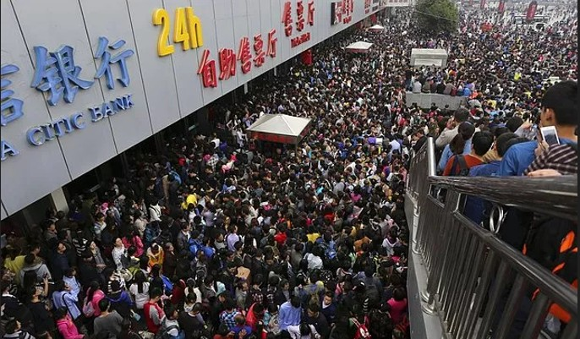
Why did we use these pictures 2 ?
#Representing the crowd in China #Increase in consumption #Increase in population
7

Slide 7

“Let's Use
”
Renewable Energy
*It is our slogan
*It aims to encourage people to use renewable energy
*The word "Let's"
8

Slide 8
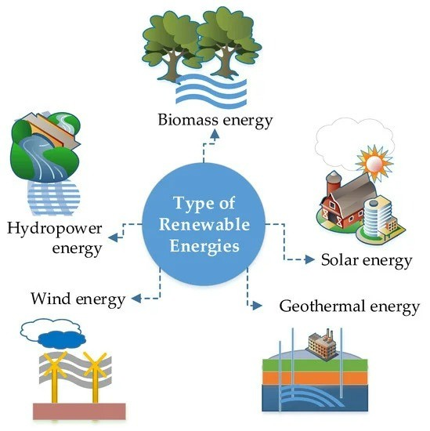
WHAT IS RENEWABLE ENERGY?
#Contribution of renewable sources
#Waste and recycle #Heat or electricity
10
Notes:
what is the renewable energy?
Renewable energy can be defined as the contribution of renewable resources to the total primary energy. Renewable energy sources include hydro, geothermal,solar and wind sources. Some renewable sources also include waste collected to be recycled at a suitable location for the generation of heat or electricity produced by local places.

Slide 9
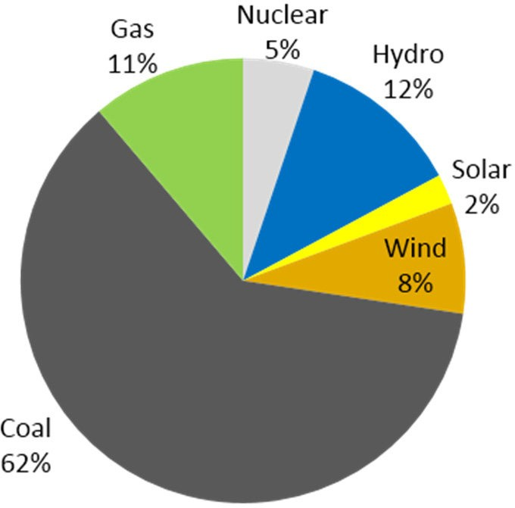
WHAT IS PRIMARY ENERGY SUPPLY?
#Energy production
#Energy imports and exports #Stocks
( It is China's graphic)

Slide 10
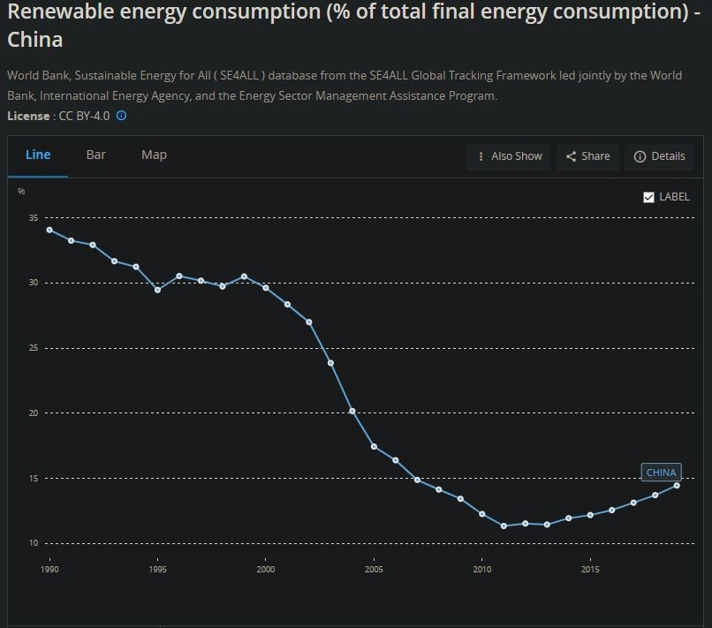
USING RENEWABLES IS IMPROVING SLOWLY
#Government funding
# CO2(Carbon Dioxide) #US-China trade war

Slide 11
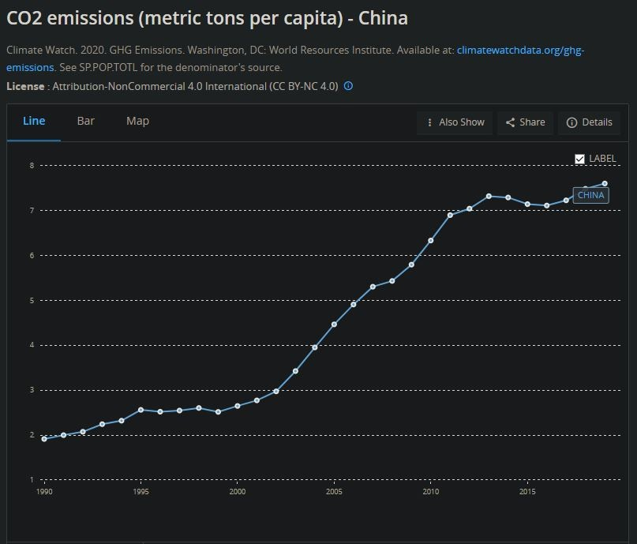
CHINA IS THE WORLD'S LARGEST EMITTER OF GREENHOUSE GASSES
#China's transition to renewable energy
#Global climate fight #Fossil fuel use rising

Slide 12
Problem 1: Increase in emitting CO2 gas
-Solution:
#Using filter #Using more renewable
energy sources

Slide 13
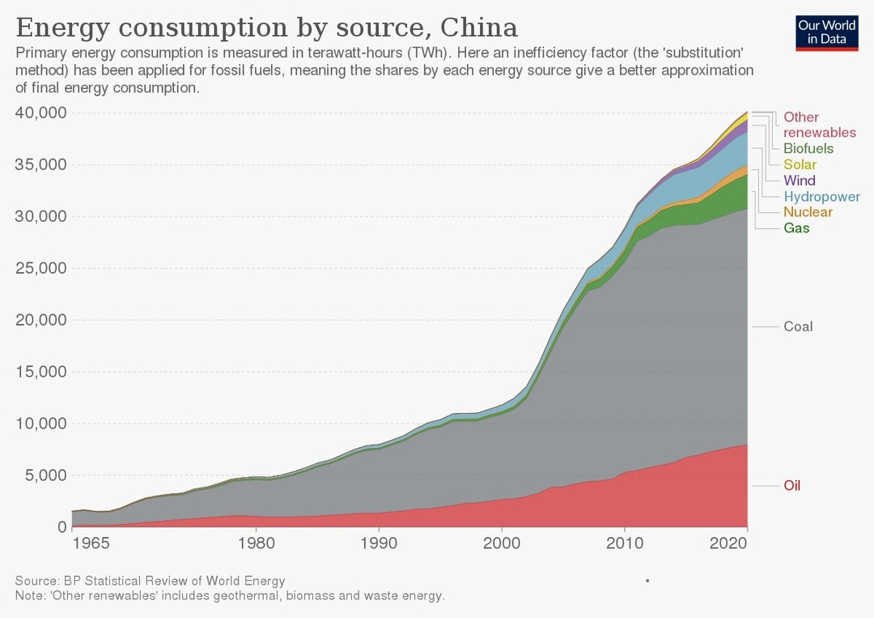
Problem 2: Insufficient use of renewable energy sources
-Solutions:
#government to allocate more budget
#encourage private companies about funding renewable sources

Slide 14
R
References For Informations
https://data.oecd.org/energy/renewable-energy.htm
https://data.oecd.org/energy/primary-energy-supply.htm#indicator-chart
https://e360.yale.edu/features/why-chinas-renewable-energy-transition-is-losing-momentum

Slide 15

Thanks for watching!
18

